Slide 1
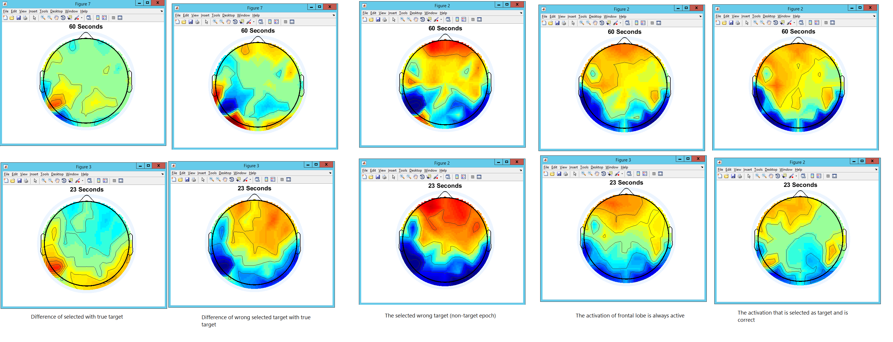
BLDA Target Features

Slide 2
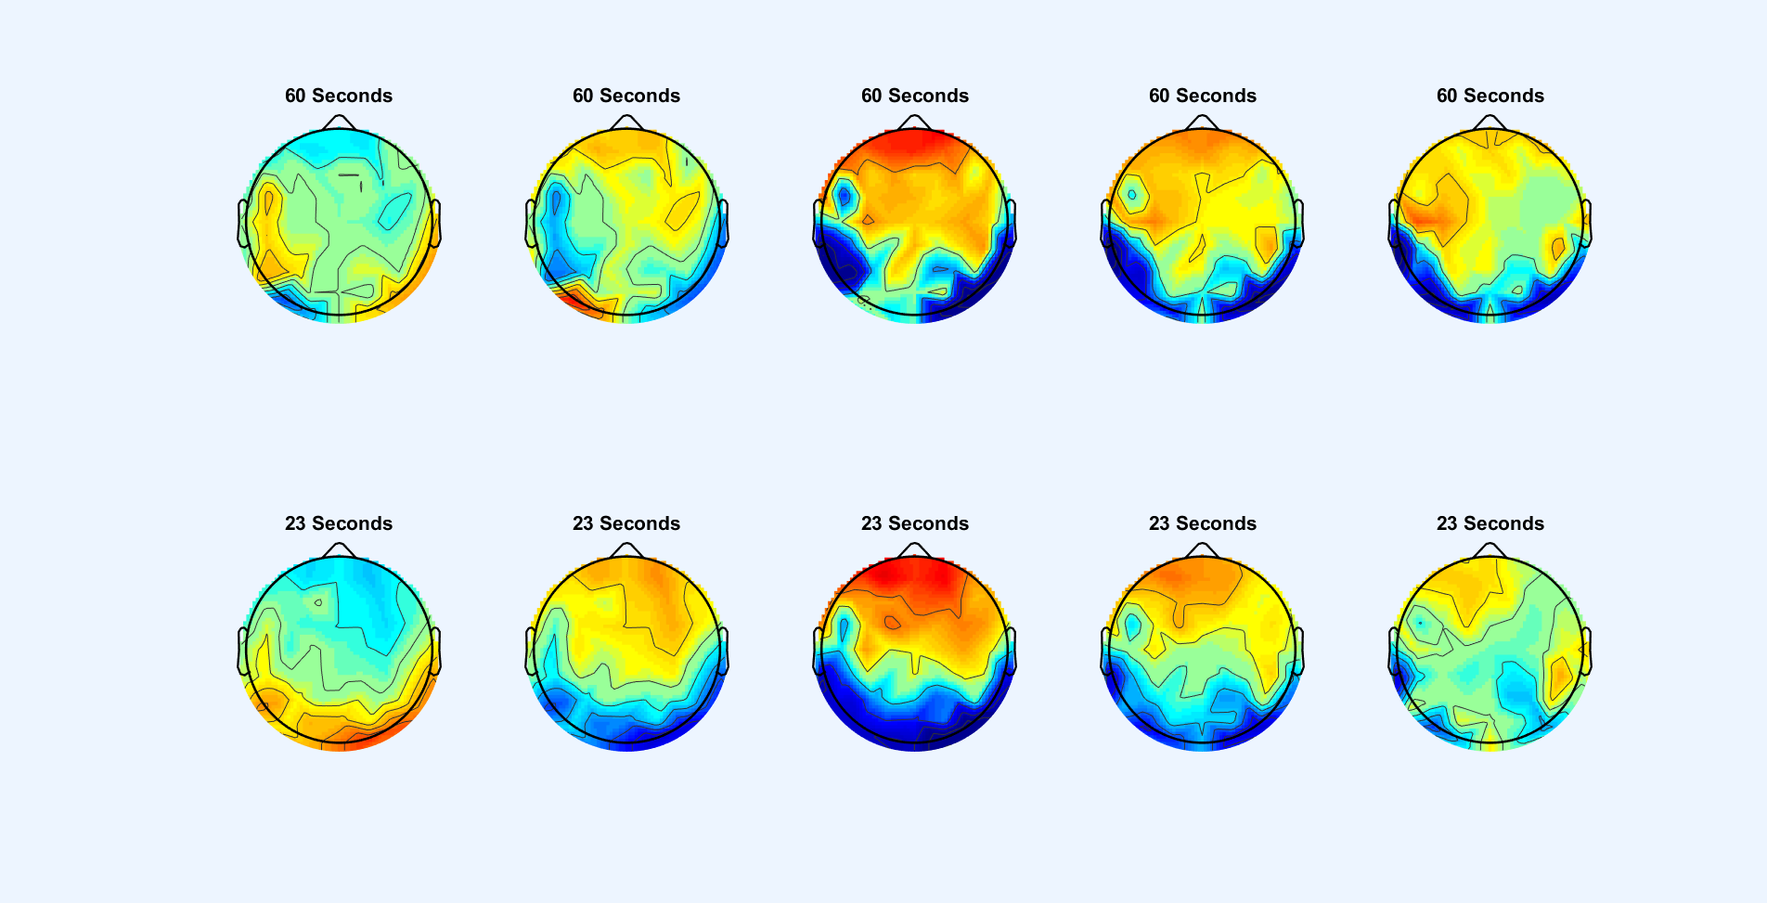
DL Target Features
Difference of
true non-target
Vs
Selected non-target
Difference of
true non-target
Vs
Selected target
Selected target
true target
Selected non-target

Slide 3
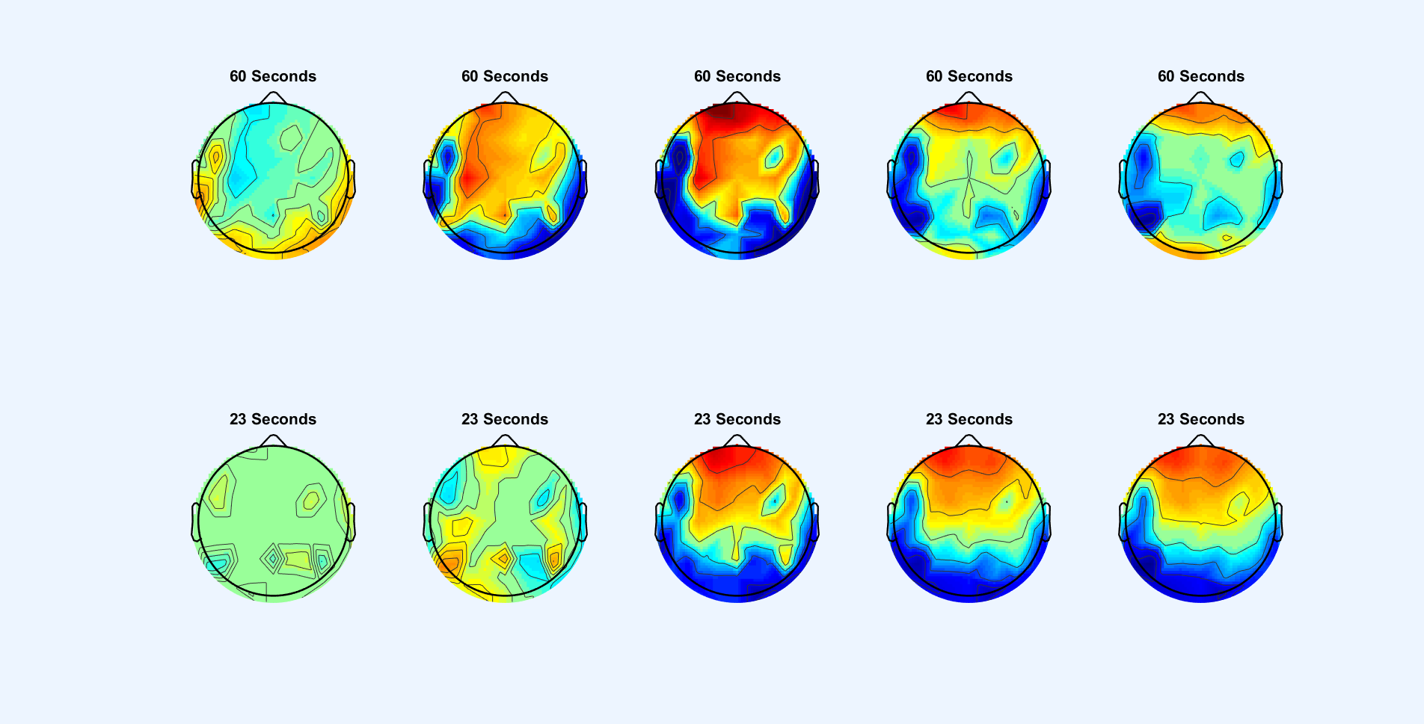
BLDA Non-Target Features
Difference of
true non-target
Vs
Selected non-target
Difference of
true non-target
Vs
Selected target
Selected target
true non-target
Selected non-target

Slide 4
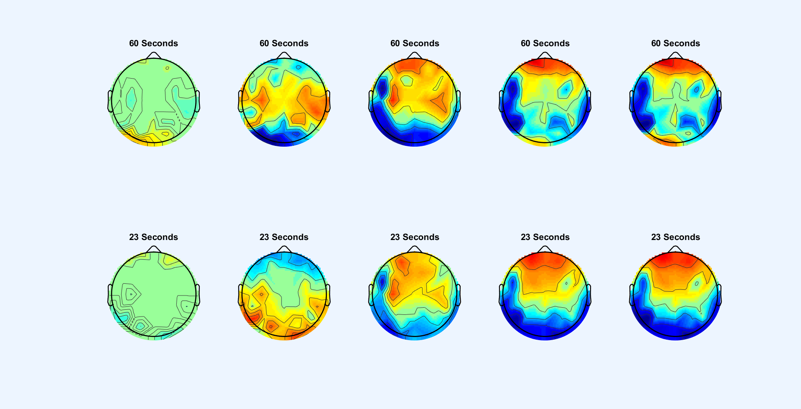
DL Non-Target Features
Difference of
true non-target
Vs
Selected non-target
Difference of
true non-target
Vs
Selected target
Selected target
true non-target
Selected non-target

Slide 5
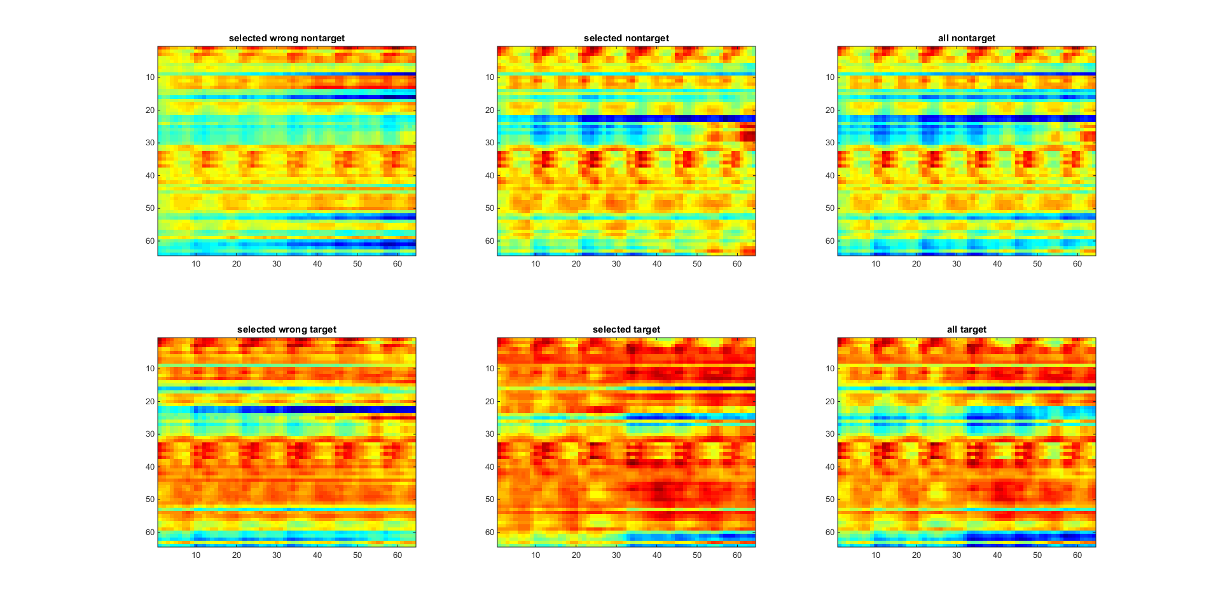
BLDA All Features

Slide 6
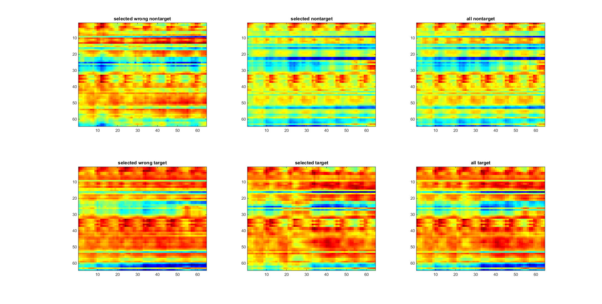
DL All Features

Slide 7
